Slide 1

MEDICAL IMAGING & BIG DATA PROJECT

Slide 2
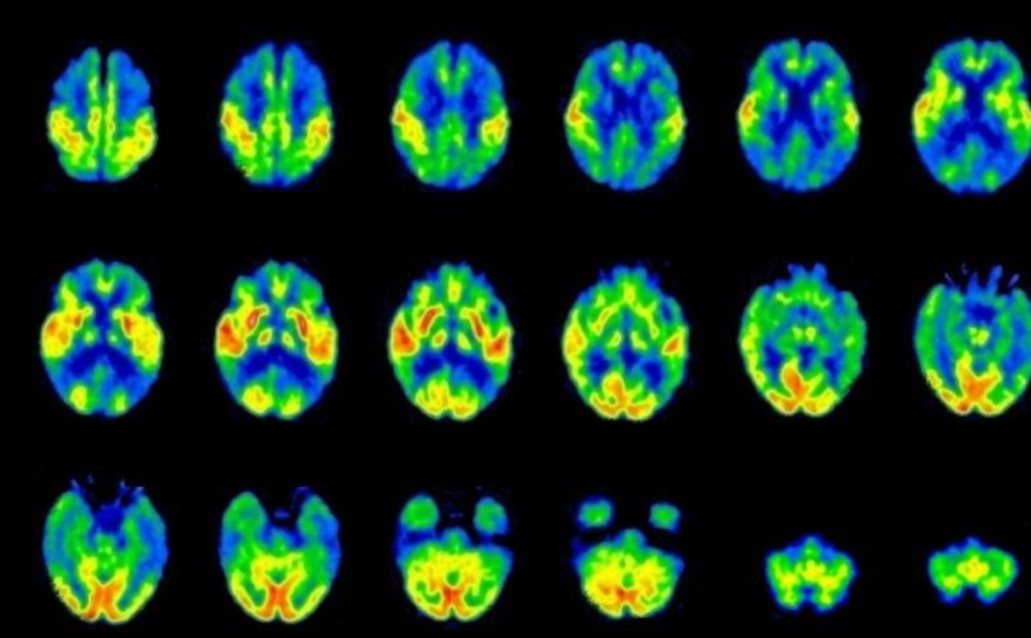
Table of contents
Goal of the Project
Machine Learning applied to medical imaging
Image pre-processing
Feature extraction
Knime model
Training
Testing
Results+images
Conclusions

Slide 3
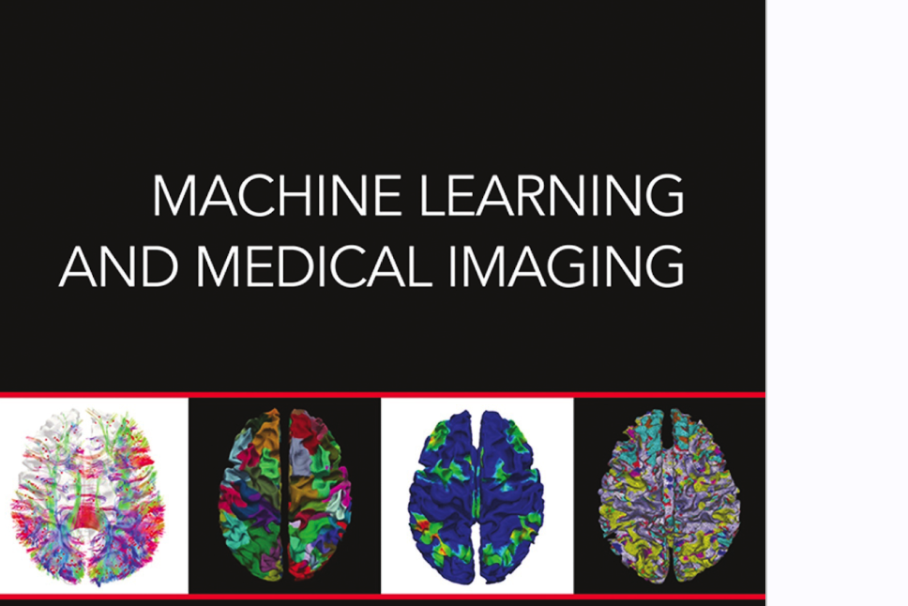
1.
Goal of the project
Let’s start with the first set of slides

Slide 4
MATLAB
KNIME
Goal of the project
The goal of the project is to create a predictive model able to classify heterogeneous and homogeneous images.
The applications used:
Matlab
Knime
PREDICTIVE MODEL
HETEROGENEOUS
HOMOGENEOUS

Slide 5
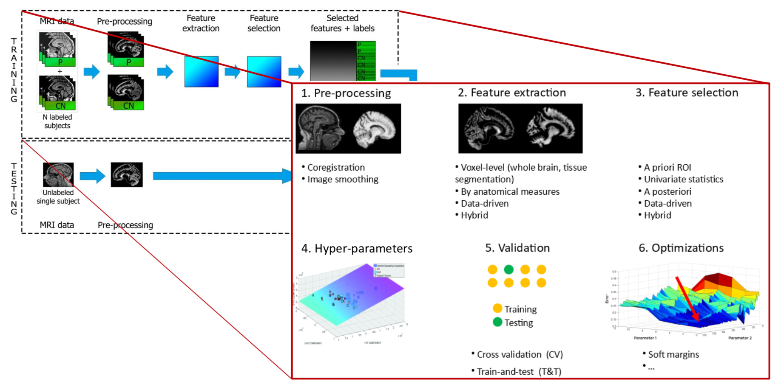
2.
Machine Learning applied to medical imaging
Let’s start with the first set of slides

Slide 6
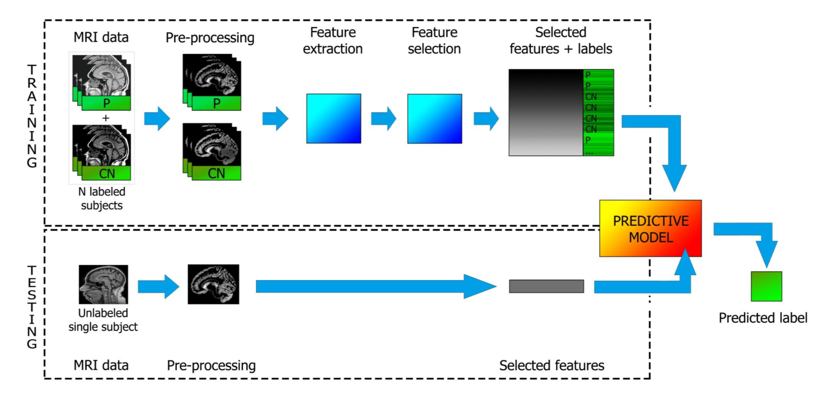
Machine learning applied to medical imaging
Machine learning is the subfield of computer science that gives "computers the ability to learn without being explicitly programmed" .
Used to classify samples by working in multidimensional spaces.
Machine learning in radiology is expected to have a substantial clinical impact with imaging examinations being routinely obtained in clinical practice, providing an opportunity to improve decision support in medical image interpretation.

Slide 7
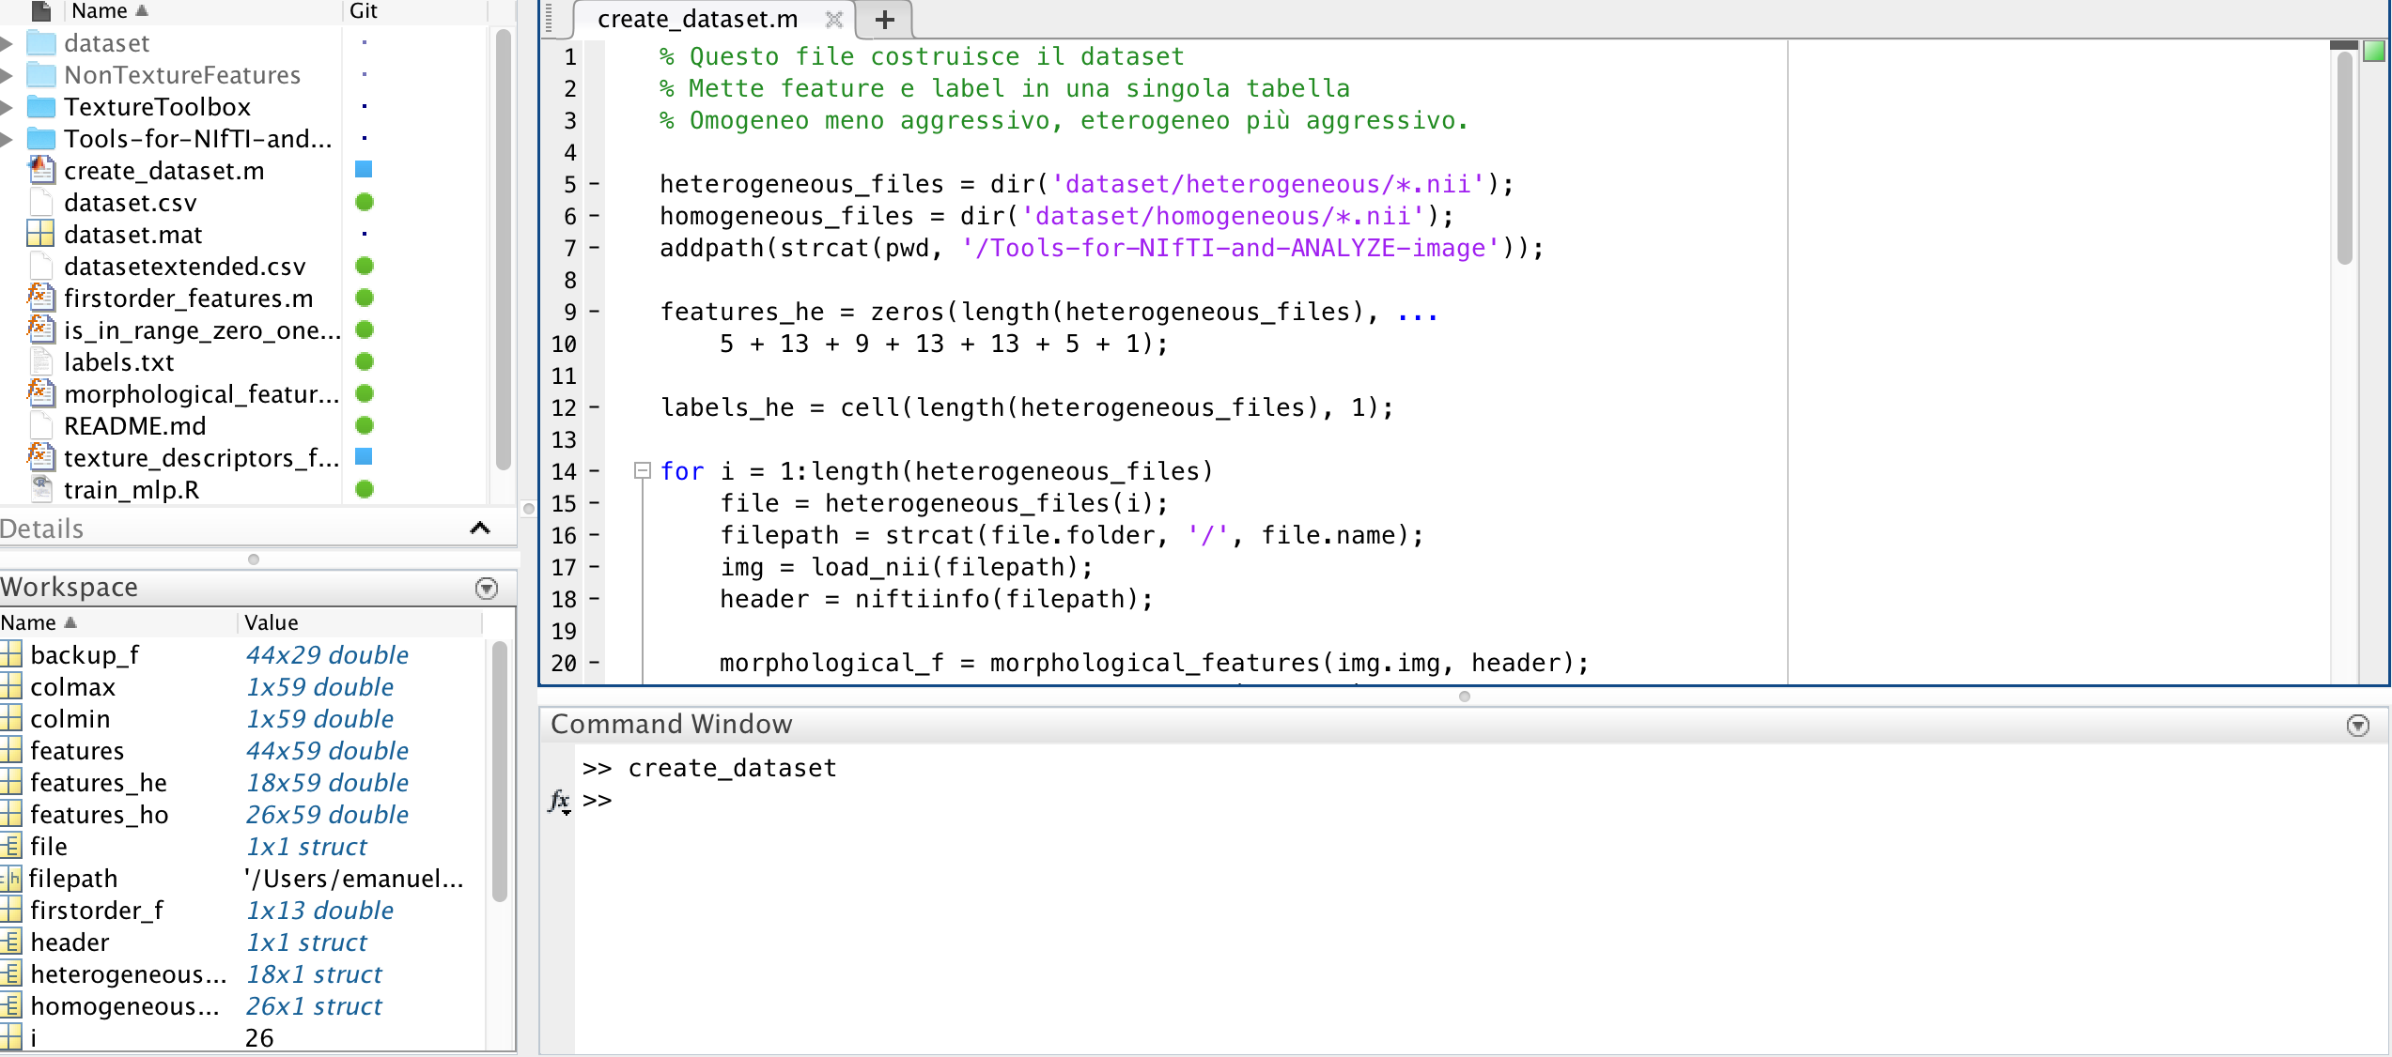
3.
Image pre-processing
Let’s start with the first set of slides

Slide 8
Image pre-processing with matlab
With the use of Matlab, we create the dataset of our analysis.
The script puts features and labels in one single table.
There is distinction between features:
Homogeneous: less aggressive.
Heterogeneous: more aggressive.
Dataset
XXX
59 COLUMNS
DESCRIPTIVE STATISTICS
XXX
XXX
XXX
XXX

Slide 9
4.
Feature extraction
Let’s start with the first set of slides

Slide 10
xxx

Slide 11
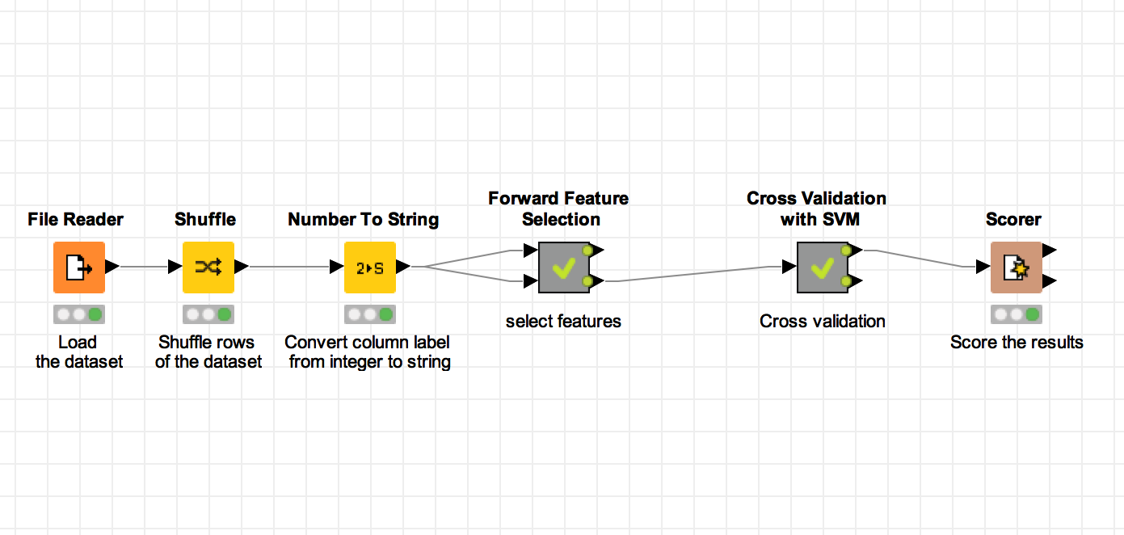
5.
Knime model
Training
Testing

Slide 12
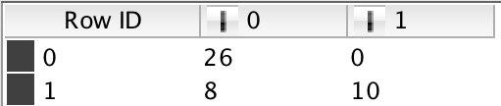

Knime model
Advantages of cross validation:
Each sample of the original dataset is used once for validation.
all samples being used for both training and testing phases.
Score of the model
Cross validation with SVM
Feature selection

Slide 13
6.
Results and images

Slide 14
xxx

Slide 15
CONCLUSIONS
89,526,124$
That’s a lot of money
89,526,124
185,244 users
And a lot of users
Description
100%
Total success!
Bring the attention of your audience over a key concept using icons or illustrations

Slide 16
xxx

Slide 17
xxx

Slide 18
xxx

Slide 19
xxx

Slide 20
xxx

Slide 21
xxx

Slide 22
xxx

Slide 23
This template is for a SlideDoc
A slidedoc is a visual document, developed in presentation software, that is intended to be read and referenced instead of projected.
Slidedocs help you spread your smart thinking by combining visual communications with short chunks of written copy. Their scannable nature makes them great pre-read, reference, and leave-behind materials. Their modularity makes it easy for people to incorporate your ideas into their own communications. And these features together make slidedocs the perfect companion to both written documents and presentations.
Text from duarte.com/slidedocs

Slide 24
Hello!
Nice to meet you
Use the first slides to present yourself or your company. Remember that you may not be presenting this document directly.
Contact us at:
www.ourwebsite.com
hello@mail.me
@companyname

Slide 25
Quotations are commonly printed as a means of inspiration and to invoke philosophical thoughts from the reader.

Slide 26
This is a slide title
SlideDocs are for distribution; they’re not optimized for presenting. Slides have too much text and font size is too small for an audience to read it projected in a screen.
These documents are useful for:
Distribute before a meeting when the topic is highly complex or technical
To fully explain your idea before booking a meeting with someone
As a reference and follow-up material
Distribute
Explain
Follow-up

Slide 27
You can also split your content
Try to communicate ideas visually using graphs, icons, illustrations, photos… any resource that helps you convey your message at a glance.
White
Is the color of milk and fresh snow, the color produced by the combination of all the colors of the visible spectrum.
Black
Is the color of coal, ebony, and of outer space. It is the darkest color, the result of the absence of or complete absorption of light.

Slide 28
In two or three columns
Yellow
Is the color of gold, butter and ripe lemons. In the spectrum of visible light, yellow is found between green and orange.
According to surveys in Europe, Canada, and the United States, yellow is the color people most often associate with amusement, gentleness, and spontaneity, but also with duplicity, envy, jealousy, avarice, and, in the U.S., with cowardice.
It plays an important role in Asian culture, particularly in China, where it is seen as the color of happiness, glory, wisdom, harmony, and culture.
Blue
Is the colour of the clear sky and the deep sea. It is located between violet and green on the optical spectrum.
Surveys in the US and Europe show that blue is the colour most commonly associated with harmony, faithfulness, confidence, distance, infinity, the imagination, cold, and sometimes with sadness.
In US and European public opinion polls it is the most popular colour, chosen by almost half of both men and women as their favourite colour.
Red
Is the color of blood, and because of this it has historically been associated with sacrifice, danger and courage.
Modern surveys in the United States and Europe show red is also the color most commonly associated with heat, activity, passion, sexuality, anger, love and joy. Red is also a color widely used for getting attention, such as stop signs or royal dresses.
In China, India and many other Asian countries it is the color of symbolizing happiness and good fortune.

Slide 29
A picture is worth a thousand words
A complex idea can be conveyed with just a single still image, namely making it possible to absorb large amounts of data quickly.

Slide 30

Want big impact? Use big image.

Slide 31
And tables to compare data
As a communication tool, a table allows a form of generalization of information from an unlimited number of different social or scientific contexts. It provides a familiar way to convey information that might otherwise not be obvious or readily understood.
 | A | B | C
Yellow | 10 | 20 | 7
Blue | 30 | 15 | 10
Orange | 5 | 24 | 16

Slide 32
Maps
our office
The word "map" comes from the medieval Latin Mappa mundi, wherein mappa meant napkin or cloth and mundi the world.

Slide 33
89,526,124
Whoa! That’s a big number, aren’t you proud?

Slide 34
And even more numbers
89,526,124$
That’s a lot of money
185,244 users
And a lot of users
100%
Total success!

Slide 35
Our process is easy
last
second
first

Slide 36
Let’s review some concepts
Yellow
Is the color of gold, butter and ripe lemons. In the spectrum of visible light, yellow is found between green and orange.
Blue
Is the colour of the clear sky and the deep sea. It is located between violet and green on the optical spectrum.
Red
Is the color of blood, and because of this it has historically been associated with sacrifice, danger and courage.
Yellow
Is the color of gold, butter and ripe lemons. In the spectrum of visible light, yellow is found between green and orange.
Blue
Is the colour of the clear sky and the deep sea. It is located between violet and green on the optical spectrum.
Red
Is the color of blood, and because of this it has historically been associated with sacrifice, danger and courage.

Slide 37
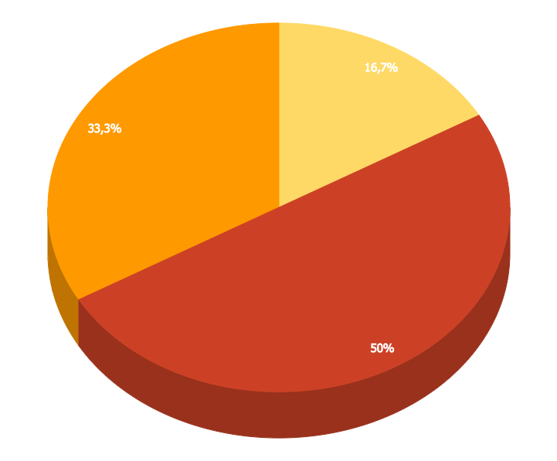
You can insert graphs from Google Sheets

Slide 38
Android Project
Place your screenshot here
Show and explain your web, app or software projects using these gadget templates.

Slide 39
iPhone Project
Place your screenshot here
Show and explain your web, app or software projects using these gadget templates.

Slide 40
Tablet
Project
Place your screenshot here
Show and explain your web, app or software projects using these gadget templates.

Slide 41
Desktop Project
Place your screenshot here
Show and explain your web, app or software projects using these gadget templates.

Slide 42
Thank you very much for your time
If you have any questions about this document please don’t hesitate to contact us at:
www.ourwebsite.com
hello@mail.me
@companyname

Slide 43
Credits
Special thanks to all the people who made and released these awesome resources for free.
Presentation template by SlidesCarnival
Photographs by Unsplash
Learn more about slidedocs at duarte.com/slidedocs

Slide 44
Presentation design
This presentation uses the following typographies and colors:
Titles: Nunito sans
Body copy: Nunito sans
Italic copy: Georgia (system font)
You can download the font on this page:
https://fontlibrary.org/en/font/nunito-sans
Orange #f67031
Yellow #ffa400
Fucsia #ed0036
You don’t need to keep this slide in your presentation. It’s only here to serve you as a design guide if you need to create new slides or download the fonts to edit the presentation in PowerPoint®

Slide 45
SlidesCarnival icons are editable shapes.
This means that you can:
Resize them without losing quality.
Change line color, width and style.
Isn’t that nice? :)
Examples:

Slide 46
😉
Now you can use any emoji as an icon!
And of course it resizes without losing quality and you can change the color.
How? Follow Google instructions https://twitter.com/googledocs/status/730087240156643328
✋👆👉👍👤👦👧👨👩👪💃🏃💑❤😂😉😋😒😭👶😸🐟🍒🍔💣📌📖🔨🎃🎈🎨🏈🏰🌏🔌🔑 and many more...

